Slide 1



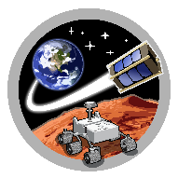
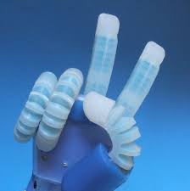
ASTEROID
SpaceTREx
(Control Farayand Pasargad Robotic Group, 2016)
Soft Robotics for Use in Space and Extreme Environments
Matthew Johnson
Mentor: Jekan Thangavelautham
Space and Terrestrial Robotic Exploration (SpaceTREx) Laboratory
University of Arizona
April 18, 2020

Slide 2
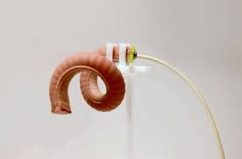
What are Soft Robotics?
Fast growing subfield of Robotics
Deals with robots that use highly adaptable materials
Main Areas to Focus On:
Mobility
Cooperation
Shaping
Leveling
(Born to Engineer, 2017)

Slide 3
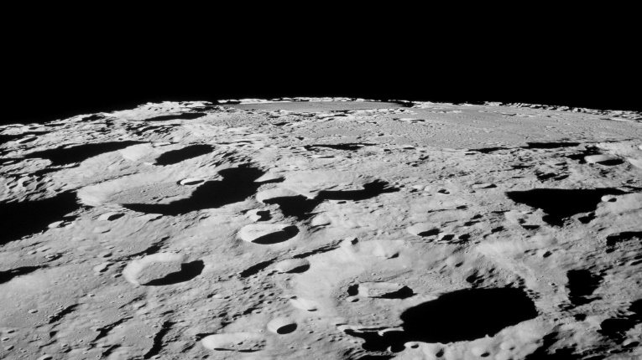
Why do we need Soft Robots?
Current Robots are rigid and cannot adapt their shape to the surroundings
Soft robots can be moldable to better work together to form new structures
Soft robots have greater degrees of freedom
Better mobility in extreme environments
(NASA, 2017)

Slide 4

What is our Vision?
To have robots that conform themselves to different environments and accomplish mission goals
To have robots cooperate to accomplish tasks
Examples:
Robots launching each other
Navigating a cavern on Mars
(Granath, 2017)

Slide 5
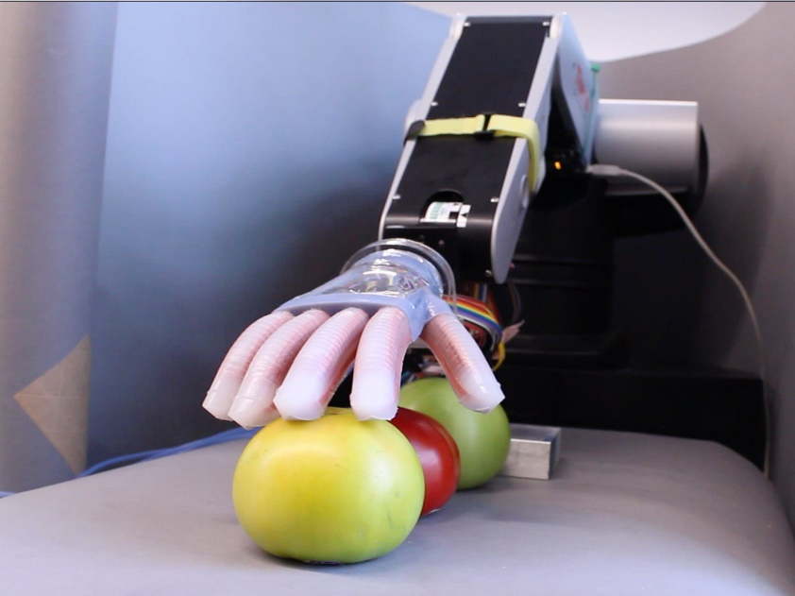
Questions We Want to Answer
How will the robots move?
What materials should we use?
How to 3D print soft robots?
How strong are the soft robots?
Will the robots succeed in extreme/space environments?
(NPR, 2016)

Slide 6
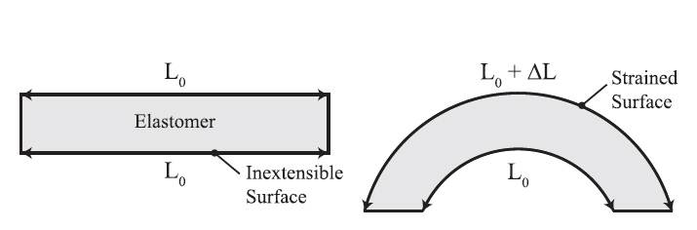
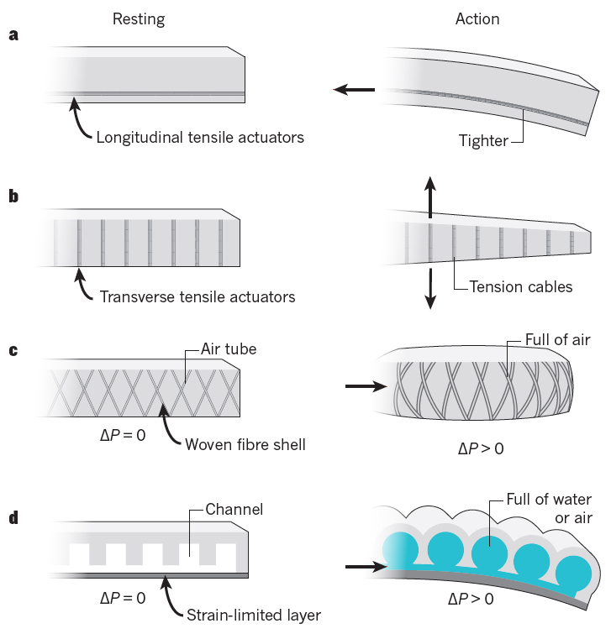
How does the Actuation of Soft Robots Work?
The soft material makes up chambers/channels
Pressurized fluids create stress in the material causing deformation
By controlling the stresses, the robot can be moved
(Sire, 2019)
(Sire, 2019)

Slide 7
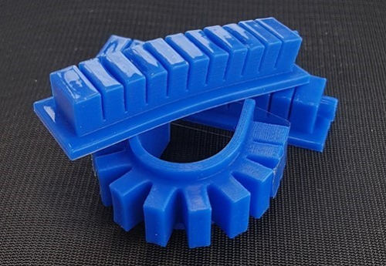
Materials to Use for Soft Robotics
Thermoplastic Polyurethane (TPU)
After a great deal of consideration, we selected TPU as a material that can achieve the goals of soft robots
(Langnau, 2018)

Slide 8
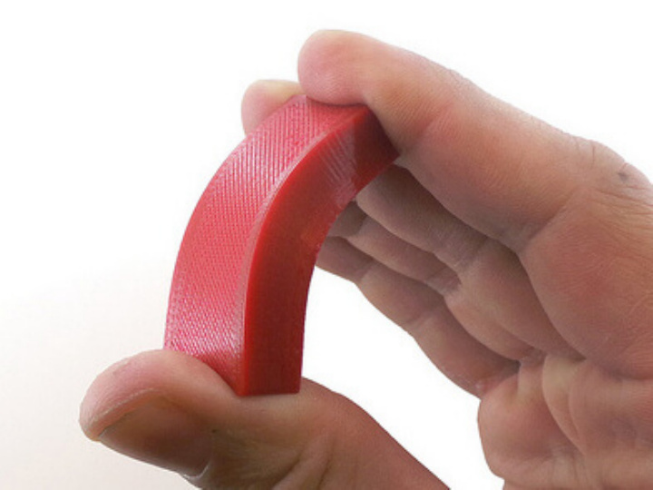
Thermoplastic Polyurethane
Known as a combination of rubber and plastic
Extremely flexible, durable, and smooth
Excellent tensile strength and elongation
Good load bearing capacity
Able to be 3D printed
Stable under high-vacuum conditions
(Ninjaflex, 2016)

Slide 9
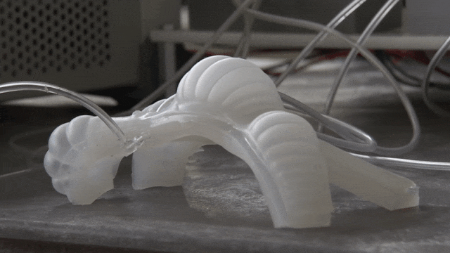
Methods and Analysis Techniques
Soft robots are designed using 3D modelling systems (Solidworks) and 3D printed
Experiments are performed to test:
Material Endurance
Material Strength
Material Adaptability
Material Movement
(Howell, 2019)

Slide 10
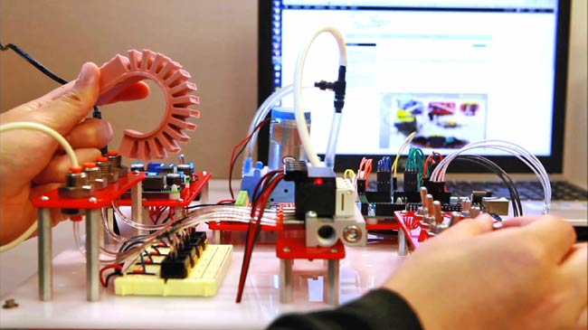
Initial Designs
Initially, we print simple actuators to test the materials
We also have designs for the future such as a a Self-Camouflaging Soft Robot
(Harvard School of Engineering and Applied Sciences, 2014)

Slide 11
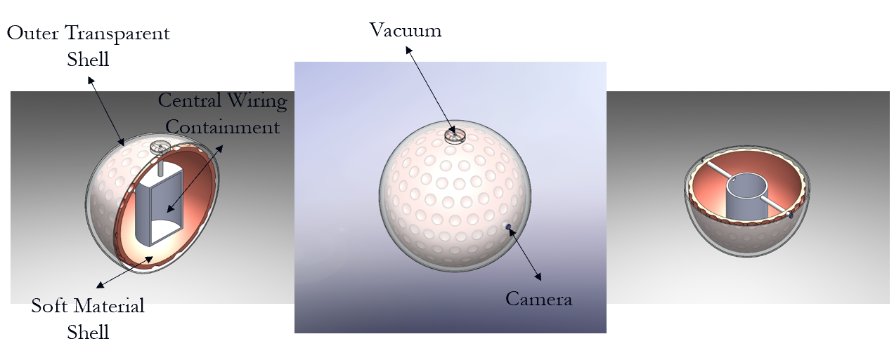
Initial Self-Camouflaging Soft Robot Design
Initial design is very simple and rudimentary
More advanced designs will be done in the future

Slide 12
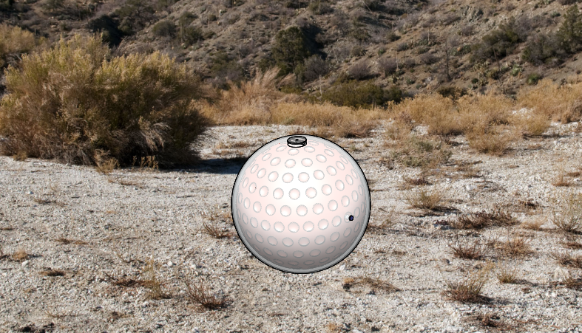
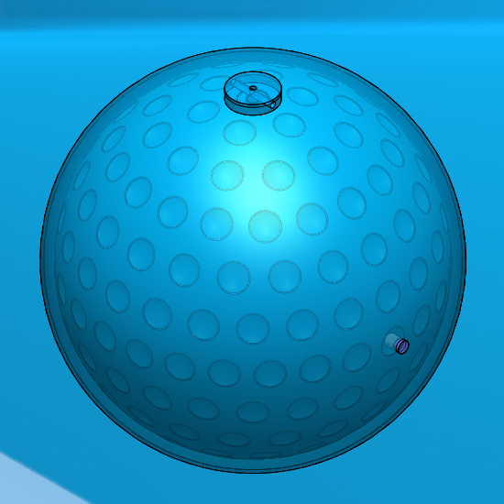
How does the Self-Camouflaging Robot Work?
Uses a vacuum to draw in external materials (sand, dirt, water, etc.) into outer transparent shell causing a camouflage effect
Movement stems from shaping the soft material shell, manipulating mass, and rolling
Cameras help steer the robot along with inner Arduino systems

Slide 13
Results and Impact
Unfortunately, due to the COVID-19 pandemic, most of our lab experiments and tests were unable to be completed
3D printers to print TPU are now in the lab ready to be used
Once we are able to get back in the lab, material printing and testing will proceed

Slide 14
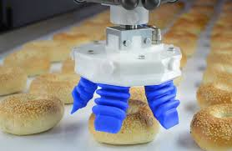
Future Work
We will first run experiments with the 3D printed TPU
Next, we will advance our soft robot designs
Then, we will 3D print our soft robots and test them further
(O’Brien, 2018)

Slide 15

Impact
We believe that soft robotic technology can revolutionize space and extreme environment exploration
A lot of research must still be done, but the future is looking bright
(Shutterstock)

Slide 16
References
Born to Engineer. (2017). Engineers control soft robots with magnetic fields — Born to Engineer. [online] Available at: https://www.borntoengineer.com/engineers-control-soft-robots-magnetic-fields [Accessed 3 April. 2020].
Burrows, L. (2015). And now, the hopping robot. [online] Harvard Gazette. Available at: https://news.harvard.edu/gazette/story/2015/07/researchers-create-jumping-soft-robot-using-3-d-printer/ [Accessed 2 April. 2020].
Control Farayand Pasargad Robotic Group. (2016). Soft Elastic Robots. [online] Available at: https://robot.cfp.co.ir/en/robots/soft-elastic [Accessed 1 April. 2020].
Harvard School of Engineering and Applied Sciences. (2014). Soft robotics ‘toolkit’ features everything a robot-maker needs. [online] Available at: https://www.seas.harvard.edu/news/2014/09/soft-robotics-toolkit-features-everything-robot-maker-needs [Accessed 2 April. 2020].
Howell, E. (2019). NASA Is Developing 'Soft Robots' to Help Explore Other Worlds. [online] Space.com. Available at: https://www.space.com/soft-robots-could-crawl-on-the-moon.html [Accessed 3 April. 2020].
Quirós, G. (2016). This Pulsating Slime Mold Comes in Peace. [online] KQED. Available at: https://www.kqed.org/science/635319/this-pulsating-slime-mold-comes-in-peace [Accessed 31 March. 2020].
Shipman, M. (2019). NCSU, Elon researchers develop technique to control, reconfigure 'soft robots' remotely | WRAL TechWire. [online] WRAL TechWire. Available at: https://www.wraltechwire.com/2019/08/13/ncsu-elon-researchers-develop-technique-to-control-reconfigure-soft-robots-remotely/ [Accessed 28 March. 2020].
Sire, W. (2019). Soft Robot - A review - Elveflow. [online] Elveflow. Available at: https://www.elveflow.com/microfluidic-tutorials/microfluidic-reviews-and-tutorials/soft-robot/ [Accessed 30 March. 2020].
Sklar, J. (2016). Meet The World First Completely Soft Robot. [online] MIT Technology Review. Available at: https://www.technologyreview.com/s/603046/meet-the-worlds-first-completely-soft-robot/ [Accessed 26 March. 2020].

Slide 17

Space and Terrestrial Robotic Exploration (SpaceTREx) Laboratory

Slide 18

Asteroid Science, Technology and Exploration Research Organized
by Inclusive eDucation (ASTEROID) Center

Slide 19


